Slide 1
INTRODUCTION
TO
ALGORITHM AND FLOWCHART

Slide 2
Introduction:
A typical programming task can be divided into two phases:
Problem solving phase
  produce an ordered sequence of steps that describe solution of problem
  this sequence of steps is called an algorithm
Implementation phase
  implement the program in some programming language

Slide 3
What is algorithm?
An algorithm is a step by step method of solving a problem.
It is commonly used for data processing, calculation and other related computer and mathematical operations.
Algorithm is generally developed before the actual coding is done.
Sometimes algorithms are written using pseudocodes, i.e. a language similar to the programming language to be used.
Pseudocode: Pseudocode is an artificial and informal language that helps programmers develop algorithms. Pseudocode is very similar to everyday English.

Slide 4
Features of pseudo code:
It uses plain English statements.
It emphasizes on the design of the computer program.
It uses structured English.
It is detailed and readable to draw an inference.
It enables the programmer to concentrate on the algorithms.
Advantages of pseudo code:
Since, it is language independent,it can be used by most programmers.
It helps to design in plain natural language.
It is easier to develop the program from pseudo code than with a flowchart.
It is easy to translate to the programming language.
Its simple structure and readability makes it easier to modify as well.

Slide 5
Example of pseudo code:
Example : Write an algorithm to determine a student’s final grade and indicate whether it is passing or failing. The final grade is calculated as the average of four marks.
Pseudocode:
Input a set of 4 marks
Calculate their average by summing and dividing by 4
if average is below 50
Print “FAIL”
else
Print “PASS”

Slide 6
Properties of Algorithm:
There should not be any ambiguity in instructions.
The instructions should be specific to the task.
The description of an algorithm must be finite. It cannot be open-ended.
As far as practicable, program codes should not be included in algorithms.
Example of algorithm:
Algorithm of previous question:
Step 1: Start
Step 2: Input four number say a, b, c, d
Step 3: calculate the GRADE ← (a+b+c+d)/4
Step 4: if (GRADE < 50) then go to step 6
Step 5:if(GRADE>50) then go to step 7
Step 6: display fail
Step 7: display pass
Step 8: Stop.

Slide 7
What is Flowchart?
A flowchart is the graphical or pictorial representation of an algorithm with the help of different symbols, shapes and arrows in order to demonstrate a process or a program.
With algorithms, we can easily understand a program. The main purpose of a flowchart is to analyze different processes.
Guidelines for Developing Flowcharts:
These are some points to keep in mind while developing a flowchart −
Flowchart can have only one start and one stop symbol.
On-page connectors are referenced using numbers.
Off-page connectors are referenced using alphabets.
General flow of processes is top to bottom or left to right.
Arrows should not cross each other.

Slide 8
Advantages of Flowchart:
It is an easy and efficient way to analyze problem using a flowchart.
It is easy in converting the flowchart into code as the logic can be understood easily.
It is an efficient way of communicating and noobs can understand easily.
It is easy in drawing a flowchart if you know the process.
Disadvantages of Flowchart:
Drawing a flowchart can be very time-consuming.
Programs are not easier in debugging.
If the flowchart is complex, writing code can be very confusing.
Even the drawing of the flowchart will be complicated if the logic is complicated.

Slide 9
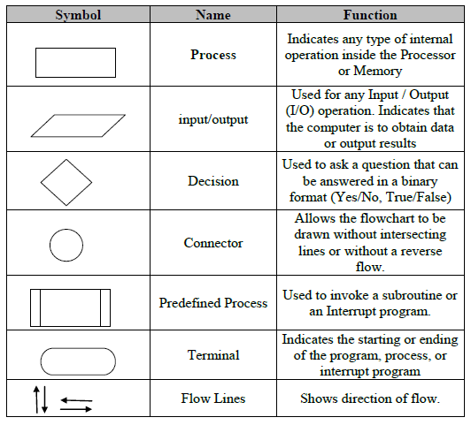
Flowchart Symbol

Slide 10
Example of Flowchart:
Flowchart of previous program:
start
Input a,b,c,d
GRADE (a+b+c+d)/4
no
Is GRADE<50
yes
Print fail
Print pass
stop

Slide 11
Flowchart vs Algorithm
Flowchart | Algorithm
Block by block information diagram representing the data flow. | Step by step instruction representing the process of any solution.
Easy to understand by any person. | Bit difficult for the layman.
It uses symbols for processes and I/O. | No symbols are used, completely in text.
Have some rule to create. | No hard and fast rule.
Difficult to debug errors. | Easy to debug errors.
It is easy to make flowchart. | It is difficult to write algorithm as compared to flowchart

Slide 12


